Slide 1


GROUP 3
Fuel Delivery System
PAKALA DISHITHA 21BCE7471
NENAVATH ANJI NAIK 21BCE9972
JAGANNADAM SRAVANI 21BCE9741
KANDRU MAHALAKSHMI 21BCE9653
S DHANUSH KRISHNAN 21BCE 9955

Slide 2
Background Study
DESCRIPTION
Introduction
Objectives
Research methodology

Slide 3
Background Study
Market Demand
Operational Feasibility
Identify the target audience
Assess the need and demand
Analyze existing solutions
Regulations and safety considerations
Logistics and infrastructure
Technology requirements:

Slide 4
Environmental Impact
Economic Feasibility
Fuel spillage and recovery
Sustainability of packaging
Emissions from delivery vehicles
Cost analysis
Pricing strategy
Potential cost benefits for customers

Slide 5
Introduction
In today's fast-paced world, convenience and efficiency are paramount. This is particularly true when it comes to fueling our vehicles, a seemingly mundane task that often consumes valuable time and resources. This is where the concept of an online fuel delivery system emerges, offering a revolutionary approach to fuel management.
This system leverages technology and logistics to deliver fuel directly to your doorstep, eliminating the need for trips to gas stations. Imagine the convenience of having your car or generator refueled while you work, rest, or attend to other priorities.

Slide 6
Behind individual convenience, online fuel delivery holds the potential to benefit businesses by streamlining their operations, reducing downtime, and potentially offering cost savings. This introduction merely scratches the surface of the possibilities offered by this innovative solution.
As we delve deeper, we will explore the various facets of online fuel delivery, from its operational feasibility

Slide 7

OBJECTIVES
objective 4
objective 1
Minimizing the expenses
Convenience and Time saving
02
03
objective 5
objective 2
01
improve fuel delivery efficiency.
Increased accessibility
06
04
objective 3
05
objective 6
Extended customer
base
Handling emergencies

Slide 8
Literature Survey
"A review of energy sources and energy management system in electric vehicle
Authors :Tie SF, Tan CW. Renew Sustain Energy Rev 2013; 20: 82–102.
The paper discusses the importance of electric vehicles (EVs) in addressing environmental concerns and reducing dependence on fossil fuels.
It highlights the limitations of current EV technology, particularly the high cost of batteries and limited driving range.
Flaws:
While acknowledging the significance of renewable energy sources, the paper doesn't delve into the challenges and opportunities related to integrating EVs with renewable energy grids.
The discussion on battery technology lacks depth, particularly regarding emerging advancements and potential future solutions for range and cost limitations.
The specific details of different control algorithms and their impact on energy efficiency are not explored in detail.

Slide 9
Current state of the fuel delivery system
"Solving a Fuel Delivery Problem by Heuristic and Exact Approaches":
This paper addresses the fuel delivery problem, aiming to optimize delivery routes and schedules for efficient fuel distribution networks
Authors Avella, P., Boccia, M., & Sforza, A. (2004)
A fleet of homogeneous trucks with identical compartment capacities.Customers requiring deliveries of different product types.
Heuristic approach: This involves using a set of rules and procedures to find a "good" solution, not necessarily the optimal one.while satisfying all constraints.
Flaws:
The limitations of the exact approach are not explicitly discussed. Solving large-scale instances of the problem using exact methods might be computationally expensive or impractical.
The paper doesn't explore the potential benefits or drawbacks of combining both approaches, such as using the heuristic to obtain initial solutions for further refinement by the exact approach.

Slide 10
Reviewing of previous research papers
"Automatic doorstep fuel delivery based on IIoT system"
Authors HS Gambhir, D Sawant, A Basu - 2022
The paper proposes a system utilizing the Industrial Internet of Things (IIoT) for automated fuel delivery to vehicles at their doorsteps.
Flaws:
The paper lacks details on the specific IIoT technologies and infrastructure required for implementation.
It doesn't address the challenges and costs associated with developing and deploying autonomous fuel delivery vehicles.
Safety concerns regarding autonomous vehicles operating in residential areas are not adequately discussed.

Slide 11

RESEARCH
METHODOLOGY

Slide 12
Admin Panel
Login: Administrators access the backend system.
Manage bookings: Administrators oversee and organize delivery bookings.
Cost management: Administrators handle pricing and financial aspects.
Manage fuel vehicles: Administrators supervise the fleet of fuel vehicles.
Track deliveries: Administrators monitor the status and progress of deliveries.

Slide 13
USER PANEL
Registration/Login: Users create accounts or log in to access the platform.
On-demand fuel/gas delivery: Users request fuel/gas delivery as needed.
Cost estimation: Users receive estimated costs for their delivery orders.
Multiple Payment methods: Users can choose from various payment options.
Tracking order: Users can monitor the progress and location of their delivery orders.
Referrals: Users can refer friends or family to the service.
Rating and reviews: Users can rate their delivery experience and leave feedback

Slide 14
Delivery Agent Panel
Availability (Online/Offline): Agents indicate their availability status.
Delivery Agent’s Dashboard: Agents access their main interface for managing tasks.
In-built navigation: Agents have access to navigation tools for route guidance.
Profile: Agents can view and update their personal information.
Payment: Agents manage their payment details and earnings.
Delivery details: Agents access information related to assigned deliveries.

Slide 15
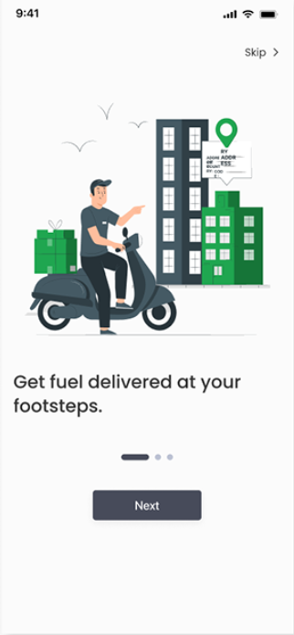
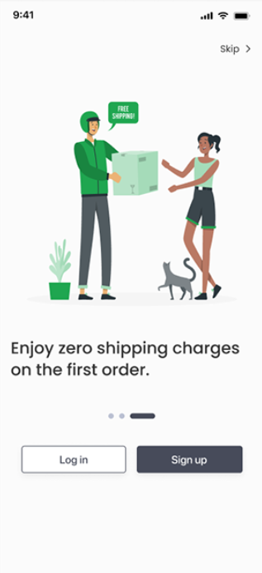
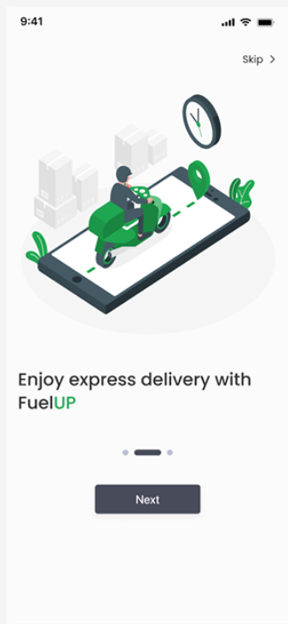
APP interface

Slide 16
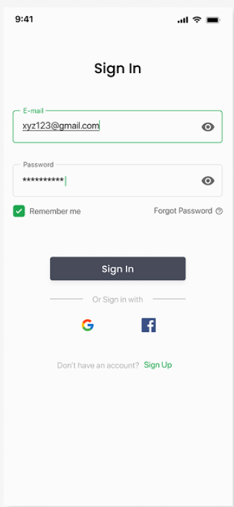

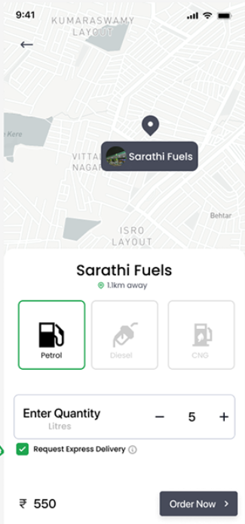
APP interface

Slide 17
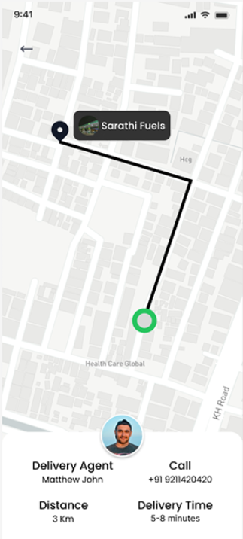
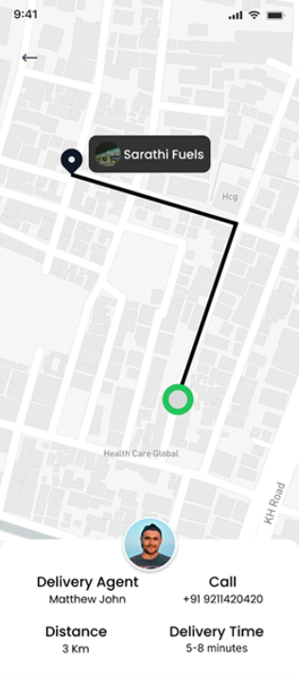
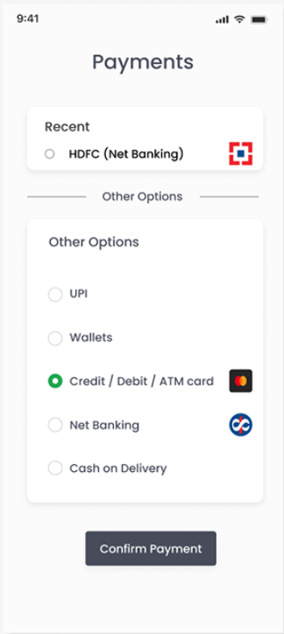
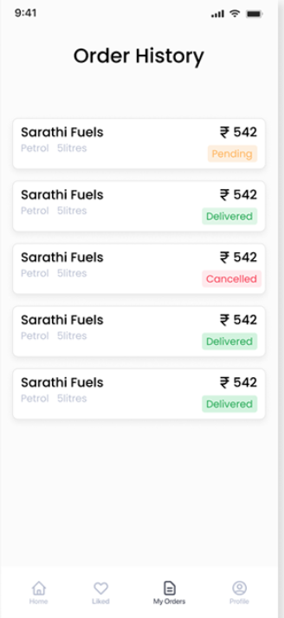
APP interface

Slide 18
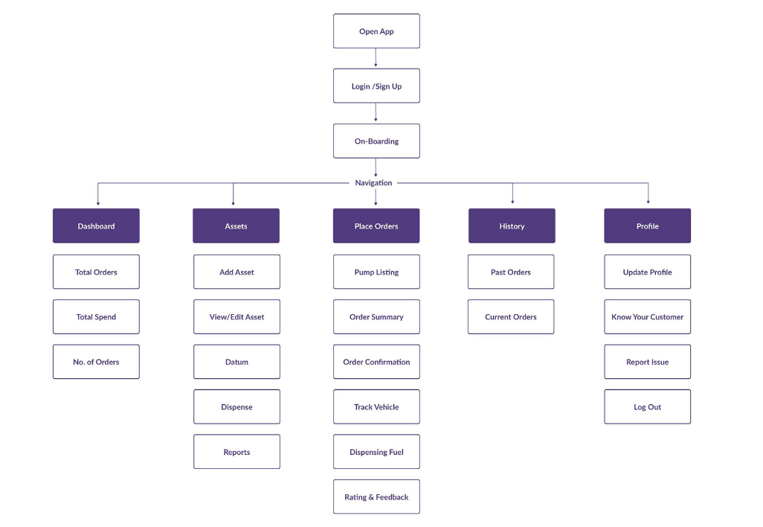
System Architecture

Slide 19
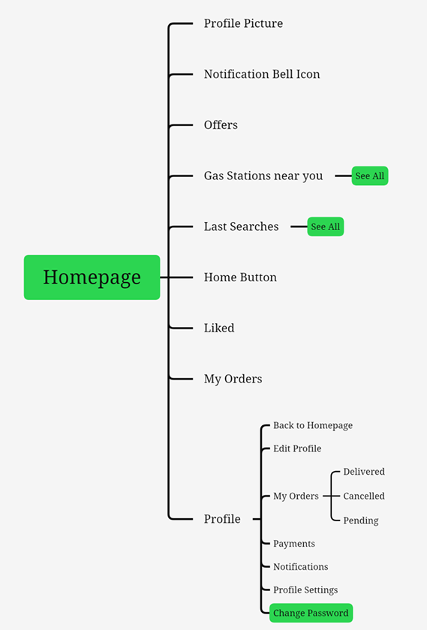

Slide 20
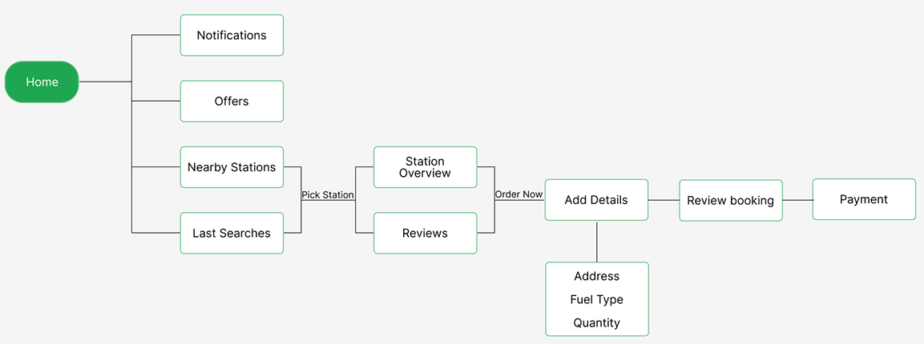
Purchase Flow

Slide 21
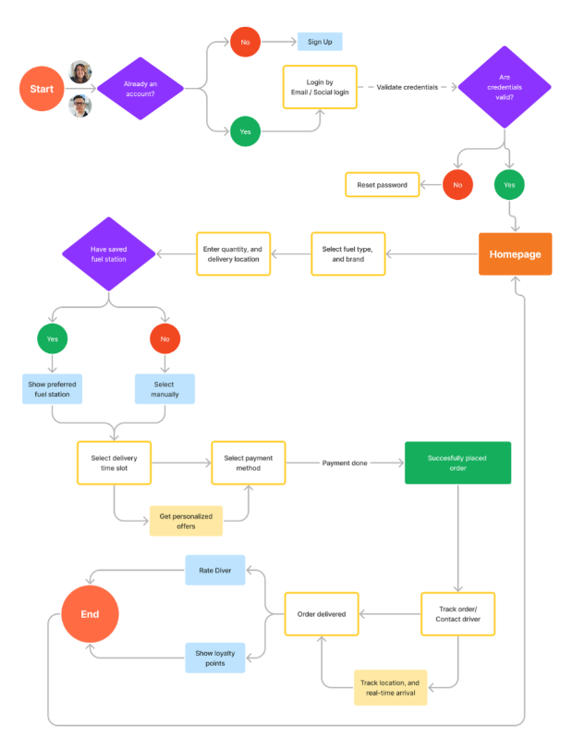
ACTIVITY DIAGRAM

